Slide 1
OU Baseball Analytics
Aswini Sivakumar
Date Presented : 15, April, 2024

Slide 2
Organization
Oakland University Athletics Baseball Team
Conference champions for the past 10 consecutive years.
Commitment to balancing sports excellence and academic goals.
Why stats in baseball?(Thorn & Palmer, 1985)
Influence of movies like Moneyball(Lewis, 2003).
Introduction of Sabermetrics into mainstream baseball discussions.
Shifting focus from just pleasing fans to strategic decision-making.
Offering every team a fair shot.

Slide 3
Problem Description
Current reliance on a third-party system, 643 charts(643 Charts, 2023)
High cost associated with the current application
Desire to enhance team performance through in-house baseball analytics
Benefits of an in-house solution
Access to more advanced statistical metrics
Quick updates with recent match data
Cost-effective for informed and timely decisions

Slide 4
Organizational Sponsors
Role | Name | Responsibility
Coaching Staff | Jordon Banfield | Subject matter expert involved in articulating the scope of the project
Project Guides | Prof. Venugopal Balijepally Prof. Vijayan Sugumaran | Provided technical oversight and mentorship. Helped scope the project and define requirements
Athletic Communication Coordinator | Michael Reedy | Provides the current XML files containing player statistics for each game played during this season
Student Contributors | Aswini Sivakumar Lauren Goralczyk | Extracted useful statistics from XML file. Developed models for predicting certain batter outcomes
Notes:
The game data is captured by the NCAA's Statcast software, which generates an XML file for every game played by our team.

Slide 5
Project Deliverables
Basic counts and advanced statistics
Excel file consolidating basic and advanced statistics extracted from XML files (Hanson, 2020).
Advanced statistical analysis provides deeper insights into data patterns and trends.
Predictive Model for RBI Outcomes
Employed machine learning algorithms:
1. Random Forest Classifier
2. Logistic Regression
3. Decision Tree Classifier
Model comparison and performance evaluation conducted.
Notes:
2 main deliverables – 1 . Advanced stats 2. predictive modeling on RBI
First deliverable – step 1 : extract attributes from XML tag
Step 2 : Collecting the formulas for advanced stats and computing them using the counts in the previous step

Slide 6
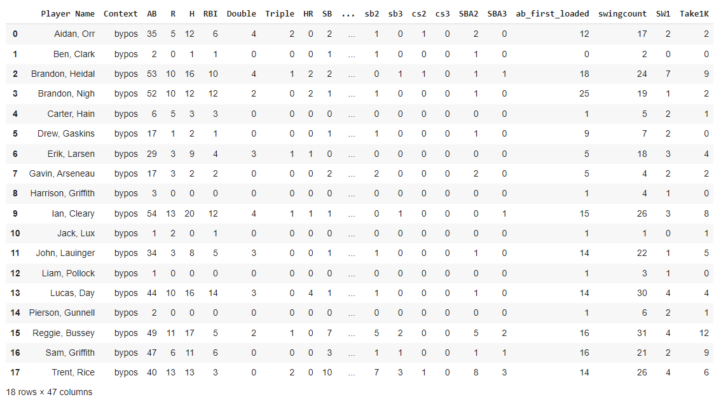
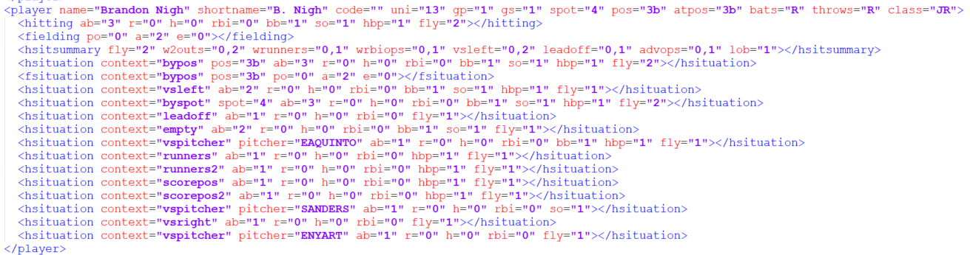
Converting XML to CSV
Notes:
2 main tags that we used for getting counts – player tag as shown here and other one is a play tag containing play by play data for every half innings.
xml.etree.ElementTree parse function came in handy to extract necessary attributes to generate the basic counting stats

Slide 7
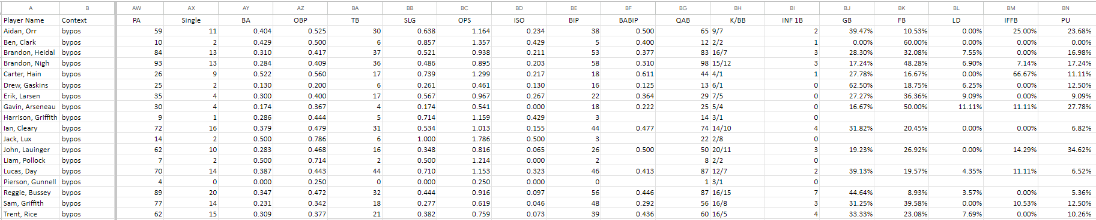
Computing Advanced metrics
The below metrics were calculated from the variables obtained from the xml files(Baseball Prospectus, 2024).

Slide 8
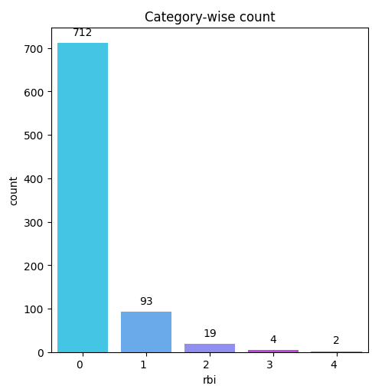
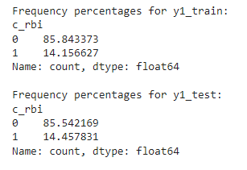
Predicting RBI outcome
Data Preparation
Exploratory Data Analysis
Feature Extraction
Model Fitting
Notes:
provides insights on how a player can contribute to the team’s offense by driving in runs given the situation

Slide 9
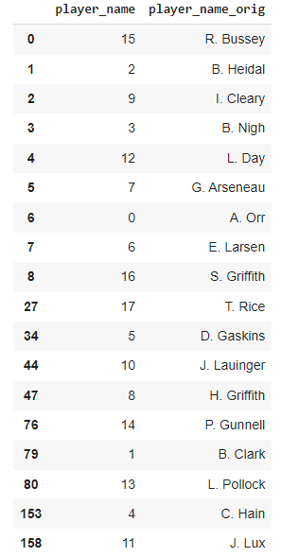
Model Selection
Logistic Regression
Random Forest Classifier
Decision Tree Classifier

Slide 10
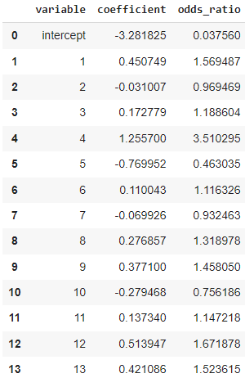
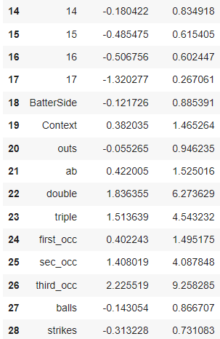
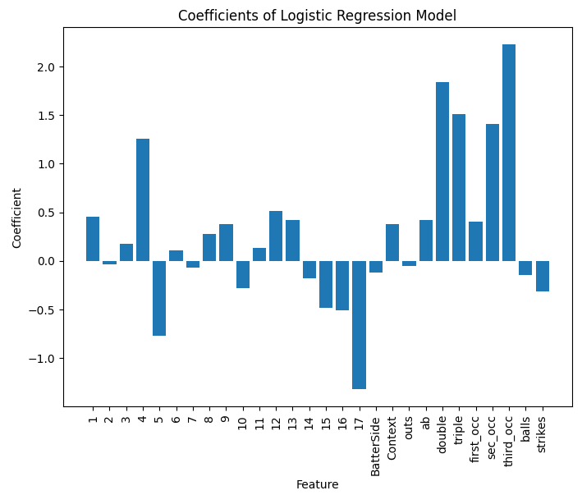
Logistic Regression
Notes:
Positive Coefficients: A positive coefficient suggests that an increase in the feature's value is associated with a higher probability of the positive outcome (RBI = 1).
Negative Coefficients: A negative coefficient implies that an increase in the feature's value is associated with a lower probability of the positive outcome.
The odds of a batter scoring an RBI when third base is occupied are 9.25 times higher compared to when third base is unoccupied. This makes sense coz that having a runner on third base creates more opportunities for RBIs, as even a simple sacrifice fly or ground ball can drive in the run.
The odds of a left-handed batter scoring an RBI are 11.5% times lower than the odds for a right-handed batter.
The odds of a batter scoring an RBI are 49% higher when the first base is occupied compared to when the first base is empty.

Slide 11
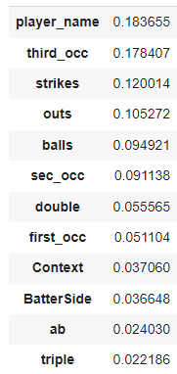
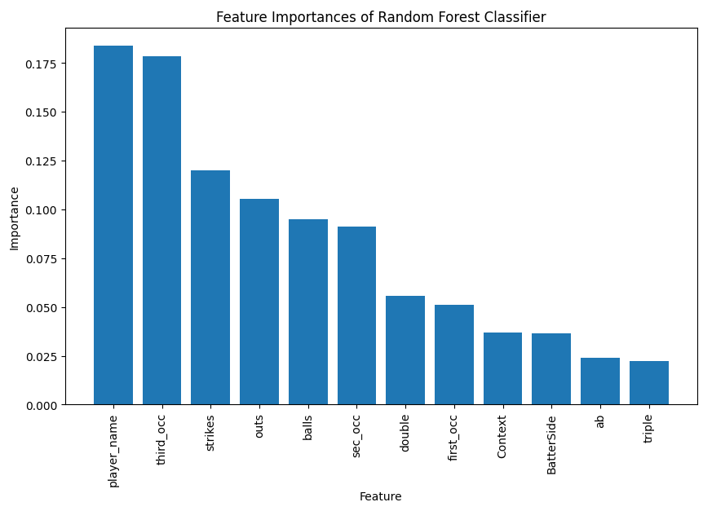
Random Forest Classifier

Slide 12
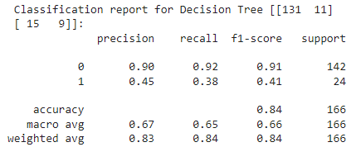
Decision Tree
Precision of class 1 is 0.45
Sensitivity is 92%
Specificity is 38% which is quite low
Notes:
The precision of class 1 is 0.45. This value represents the number of correctly identified "1s" divided by the total number of times the classifier predicted "1," whether correctly or incorrectly. Therefore, this indicates that the classifier correctly identified "1s" 45% of the time it predicted a "1".
The sensitivity as indicated by recall of class 0 is 92% and the specificity as indicated by recall of class 1 is 38% which is quite low. The specificity is quite improved compared to the other 2 models.

Slide 13
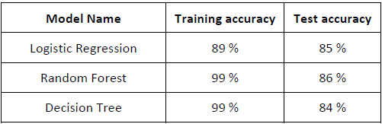
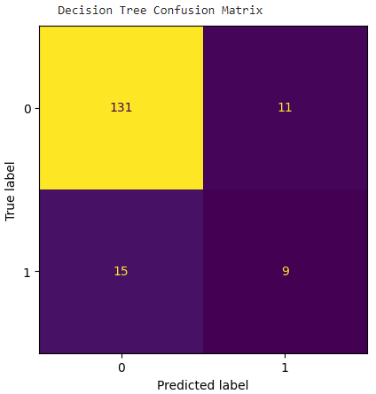
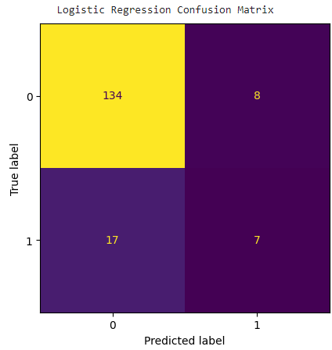
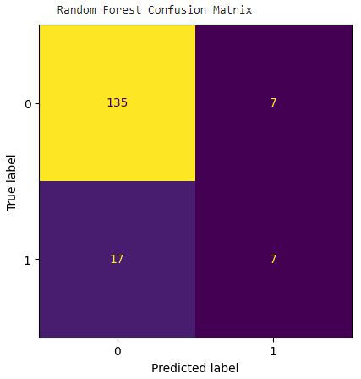
Model Analysis
Notes:
Model can further be improved by adding more relevant variables like pitch type and pitch sequence. Also the model can be tuned by specifying the model criterion for pruning such as gini or entropy.

Slide 14
Limitations and Future Scope
Limitations:
Current solution limited to XML files, potential changes in file format may require code adjustments.
Lack of detailed pitch data restricts model sophistication for predicting outcomes like RBI.
Future scope:
Integrate pitch type data to enhance predictive models.
Include additional data sources like scouting reports and trackman data for deeper insights.
Automate data processes for streamlined operations and timely insights.

Slide 15
References
643 Charts. (2023). Interactive Stats – 6–4–3 Charts. Retrieved April 9, 2024 from 6–4–3 Charts: https://643charts.com/web-application/
Baseball Prospectus. (2024). Glossary. Retrieved April 11, 2024 from Baseball Prospectus: https://legacy.baseballprospectus.com/glossary/
Hanson, C. R. (2020, March 1). Getting started using Python’s ElementTree to navigate XML files. CoreyHanson. Retrieved April 11, 2024, from https://coreyhanson.com/blog/getting-started-using-pythons-elementtree-to-navigate-xml-files/
Lewis, M. (2003). Moneyball: The Art of Winning an Unfair Game. W. W. Norton & Company.
Thorn, J., & Palmer, P. (1985). The Hidden Game of Baseball. Doubleday.

Slide 16
Thank you

